Slide 1
Efficient Algorithms
Ekkapot Charoenwanit
Software Systems Engineering
TGGS
KMUTNB

Slide 2
Lecture 3: Data Structures (Part I)
Stack, Queue, Heap, Priority Queue

Slide 3
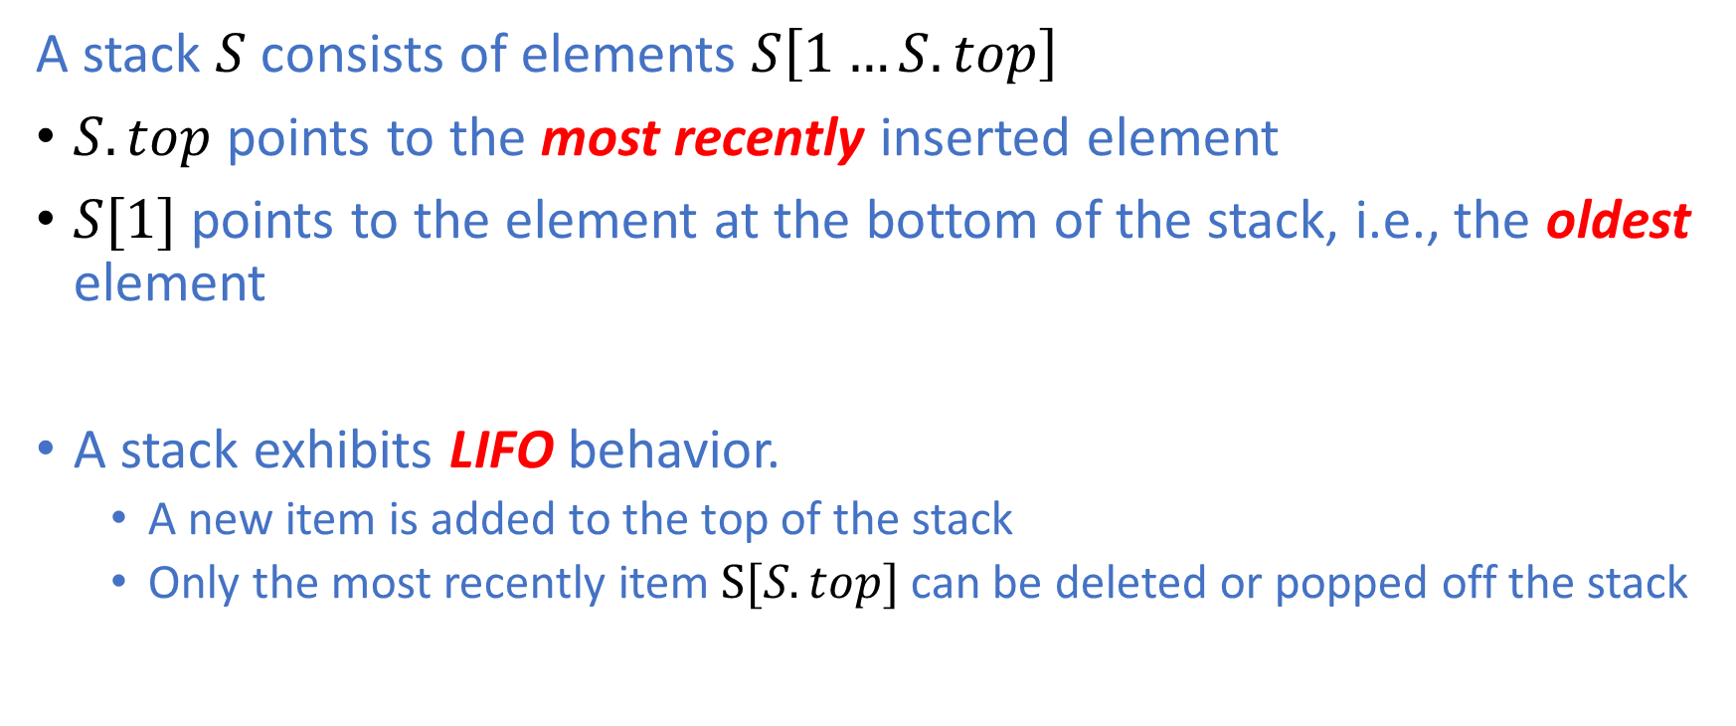
Stack
A stack $S$ consists of elements $S\left[1…S.top\right]$
$S.top$ points to the most recently inserted element
$S[1]$ points to the element at the bottom of the stack, i.e., the oldest element
A stack exhibits LIFO behavior.
A new item is added to the top of the stack
Only the most recently item $S[S.top]$can be deleted or popped off the stack

Slide 4
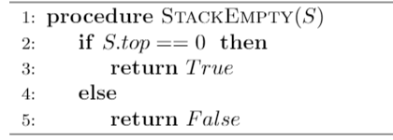
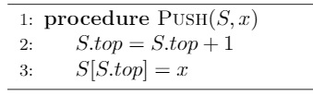
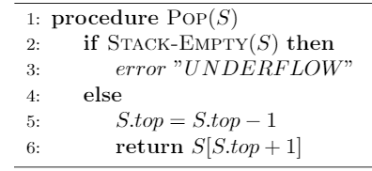
Stack Operations

Slide 5
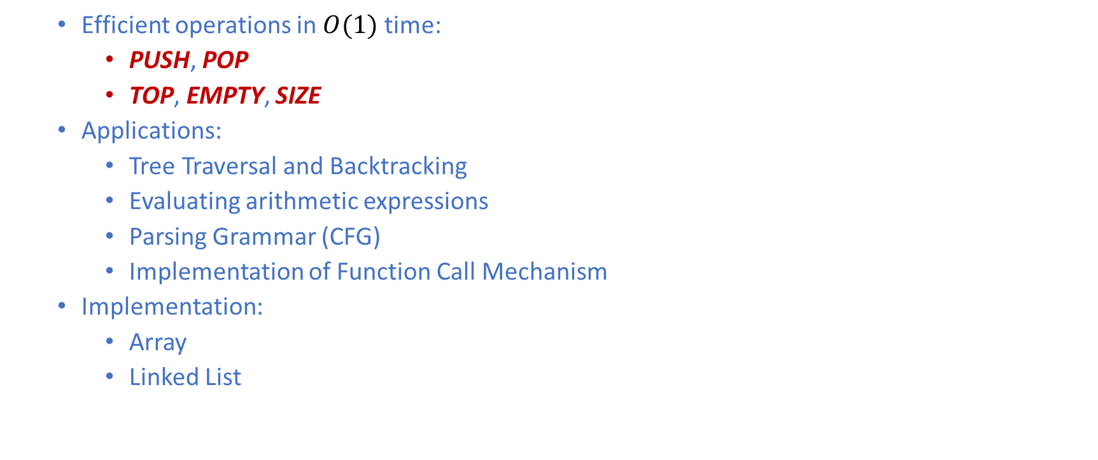
The Time Complexity of Stack Operations
Efficient operations in $O(1)$ time:
PUSH, POP
TOP, EMPTY, SIZE
Applications:
Tree Traversal and Backtracking
Evaluating arithmetic expressions
Parsing Grammar (CFG)
Implementation of Function Call Mechanism
Implementation:
Array
Linked List

Slide 6
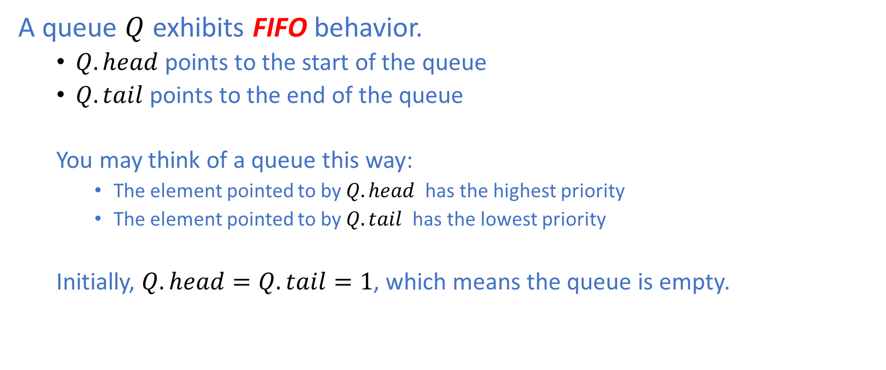
Queue
A queue $Q$ exhibits FIFO behavior.
$Q.head$ points to the start of the queue
$Q.tail$ points to the end of the queue
You may think of a queue this way:
The element pointed to by $Q.head$ has the highest priority
The element pointed to by $Q.tail$ has the lowest priority
Initially, $Q.head=Q.tail=1$, which means the queue is empty.

Slide 7
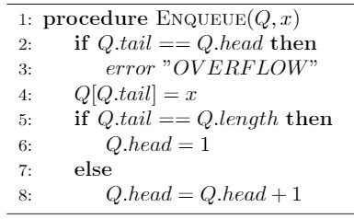
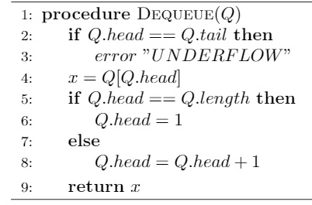
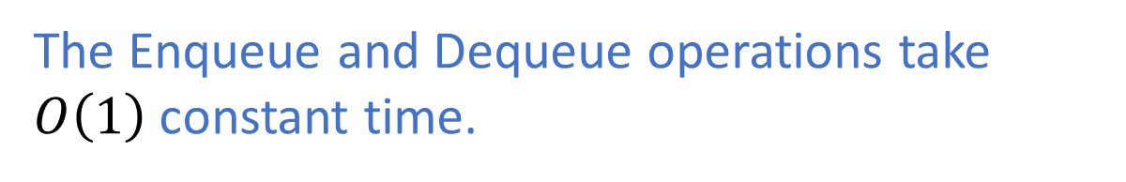
Queue Operations
The Enqueue and Dequeue operations take $O\left(1\right)$constant time.

Slide 8
Binary Heap
A binary heap (or simply heap) is an array which represents an ordered binary tree:
all levels of a binary tree are filled except possibly for the last level, which is filled from left to right
This property is referred to as being a Nearly Complete Binary Tree.
values stored at each node obey the MIN/MAX Heap Property, depending on which kind of heap the heap is.

Slide 9
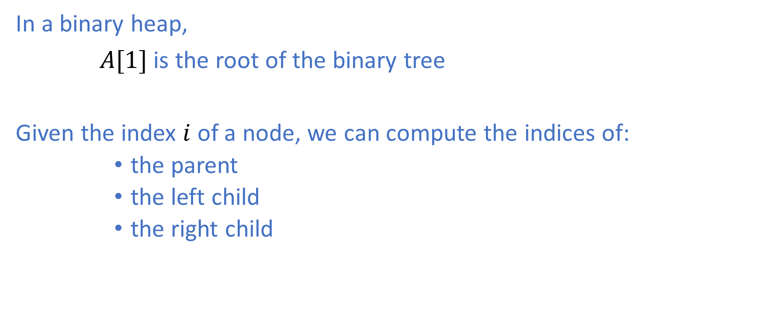
Binary Heap
In a binary heap,
$A[1]$ is the root of the binary tree
Given the index $i$ of a node, we can compute the indices of:
the parent
the left child
the right child

Slide 10



Parent-Child Relationship
***Assume array indexing starts at 1.

Slide 11
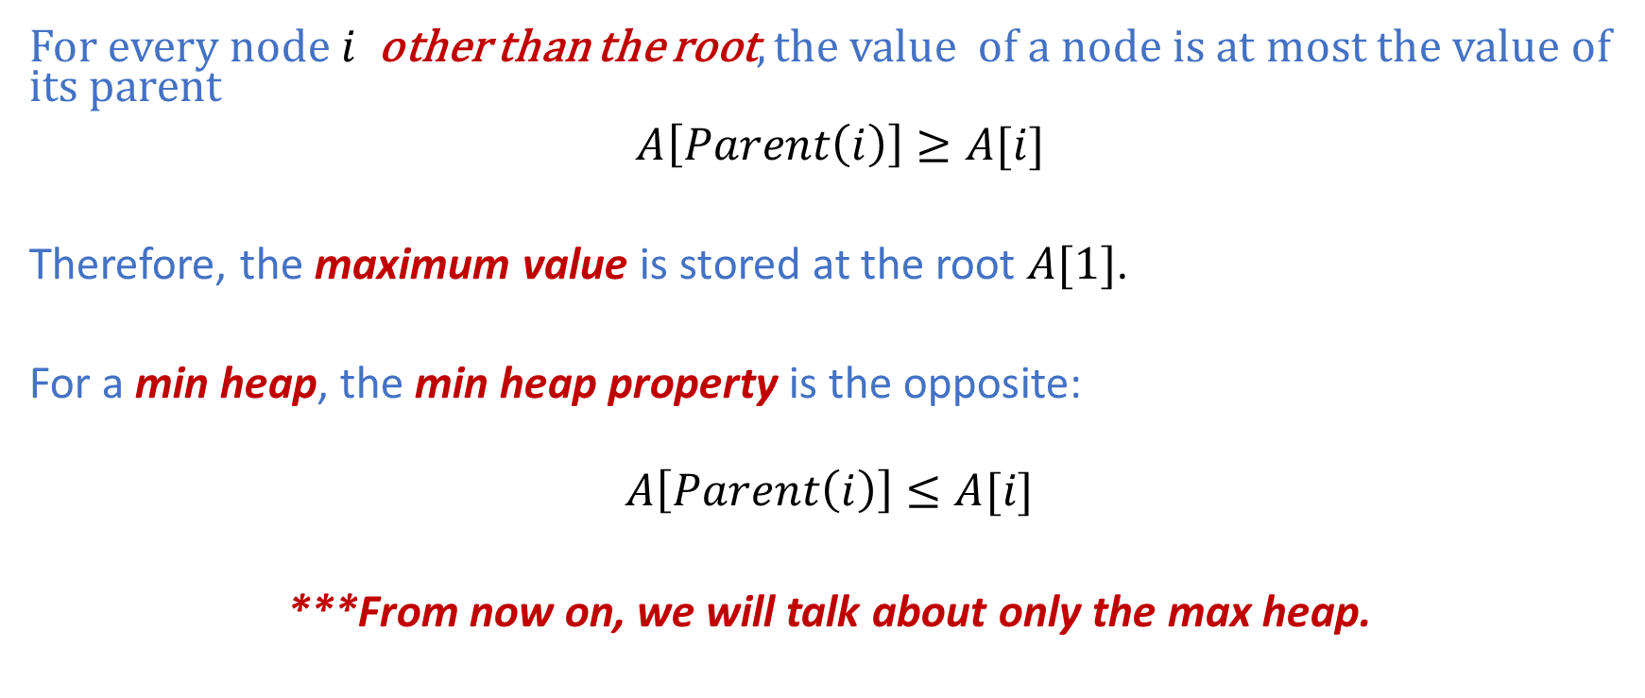
The Max Heap Property
For every node $i$ other than the root, the value of a node is at most the value of its parent
$A\left[Parent\left(i\right)\right]≥A[i]$
Therefore, the maximum value is stored at the root $A[1]$.
For a min heap, the min heap property is the opposite:
$$A\left[Parent\left(i\right)\right]≤A[i]$$
***From now on, we will talk about only the max heap.

Slide 12
The Max Heap Property
Is this array a max heap [29,22,19,16,20,15,9,7,10]?
29
19
22
16
20
15
9
7
10

Slide 13
Definition of the Height of a Tree
Definition I:
The height of a node is the number of edges on the longest simple path from that node to a leaf.
Definition II:
The height of a tree is the height of the root.

Slide 14
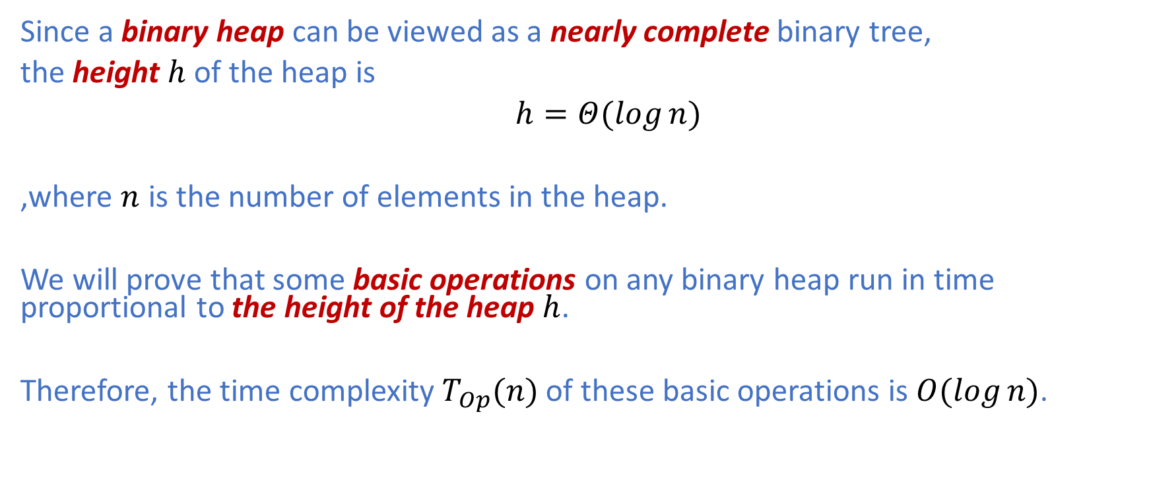
Definition of the Height of a Tree
Since a binary heap can be viewed as a nearly complete binary tree,
the height $h$ of the heap is
$h=Θ(\log{n)}$
,where $n$ is the number of elements in the heap.
We will prove that some basic operations on any binary heap run in time proportional to the height of the heap $h$.
Therefore, the time complexity $T_{Op}(n)$ of these basic operations is $O(\log{n)}$.

Slide 15
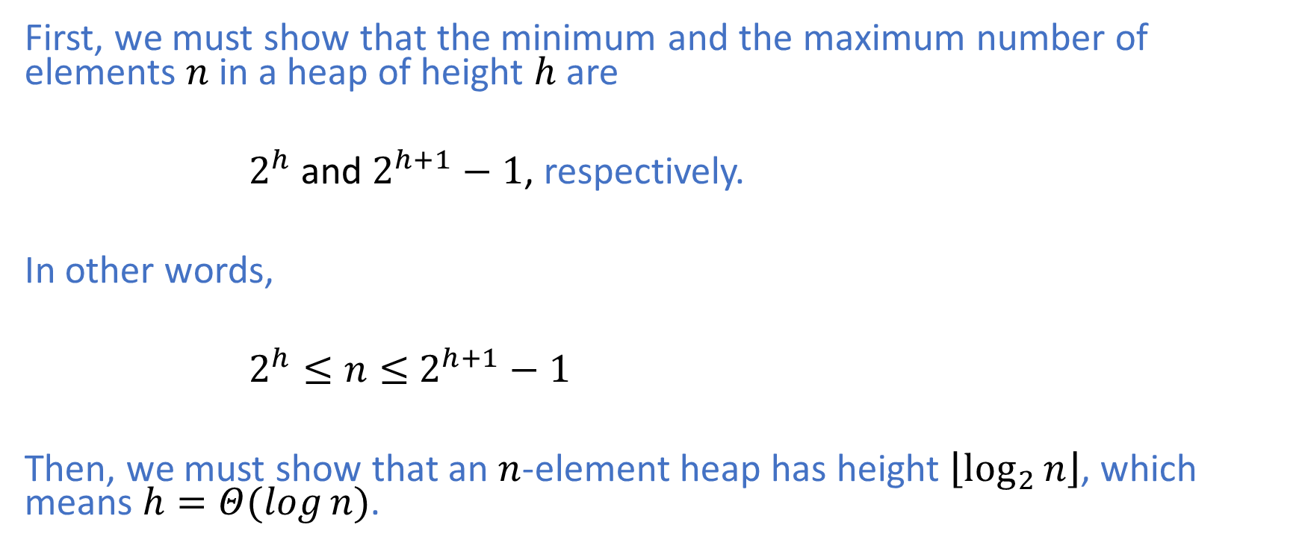
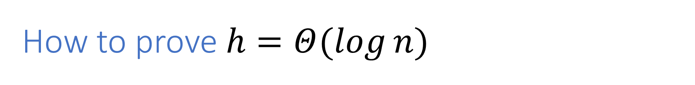
How to prove $h=Θ(\log{n)}$
First, we must show that the minimum and the maximum number of elements $n$ in a heap of height $h$ are
$2^{h}$ and $2^{h+1}−1$, respectively.
In other words,
$2^{h}≤n≤$ $2^{h+1}−1$
Then, we must show that an $n$-element heap has height $\left\lfloor \log_{2}{n}\right\rfloor$, which means $h=Θ(\log{n)}$.

Slide 16
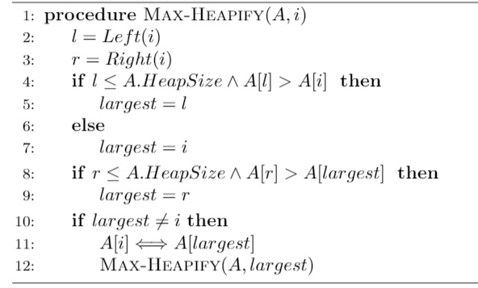
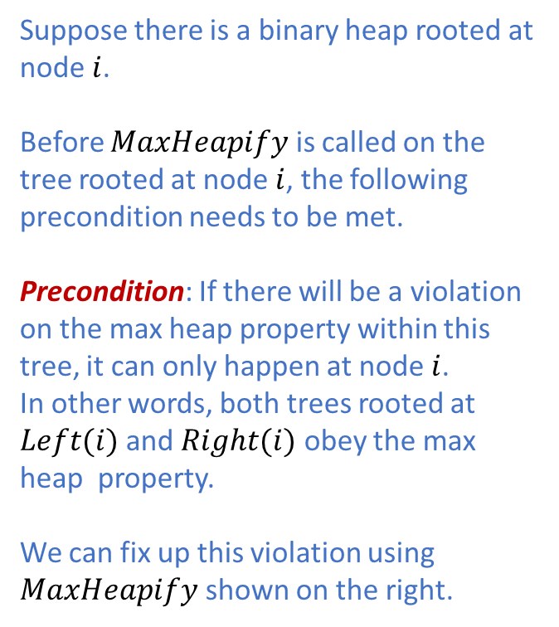
Max-Heapify
Suppose there is a binary heap rooted at node $i$.
Before $MaxHeapify$ is called on the tree rooted at node $i$, the following precondition needs to be met.
Precondition: If there will be a violation on the max heap property within this tree, it can only happen at node $i$.
In other words, both trees rooted at $Left(i)$ and $Right(i)$ obey the max heap property. We can fix up this violation using $MaxHeapify$ shown on the right.

Slide 17
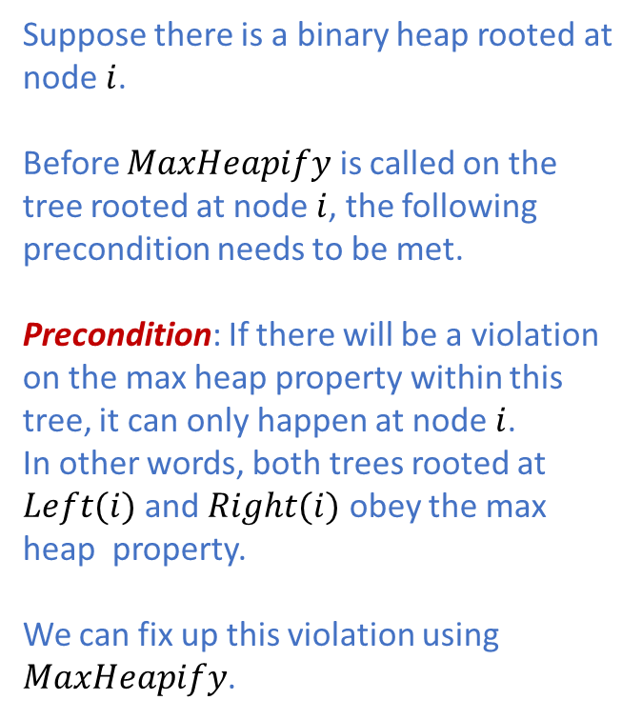
Max-Heapify
i
Suppose there is a binary heap rooted at node $i$.
Before $MaxHeapify$ is called on the tree rooted at node $i$, the following precondition needs to be met.
Precondition: If there will be a violation on the max heap property within this tree, it can only happen at node $i$.
In other words, both trees rooted at $Left(i)$ and $Right(i)$ obey the max heap property. We can fix up this violation using $MaxHeapify$.
Left(i)
Right(i)

Slide 18
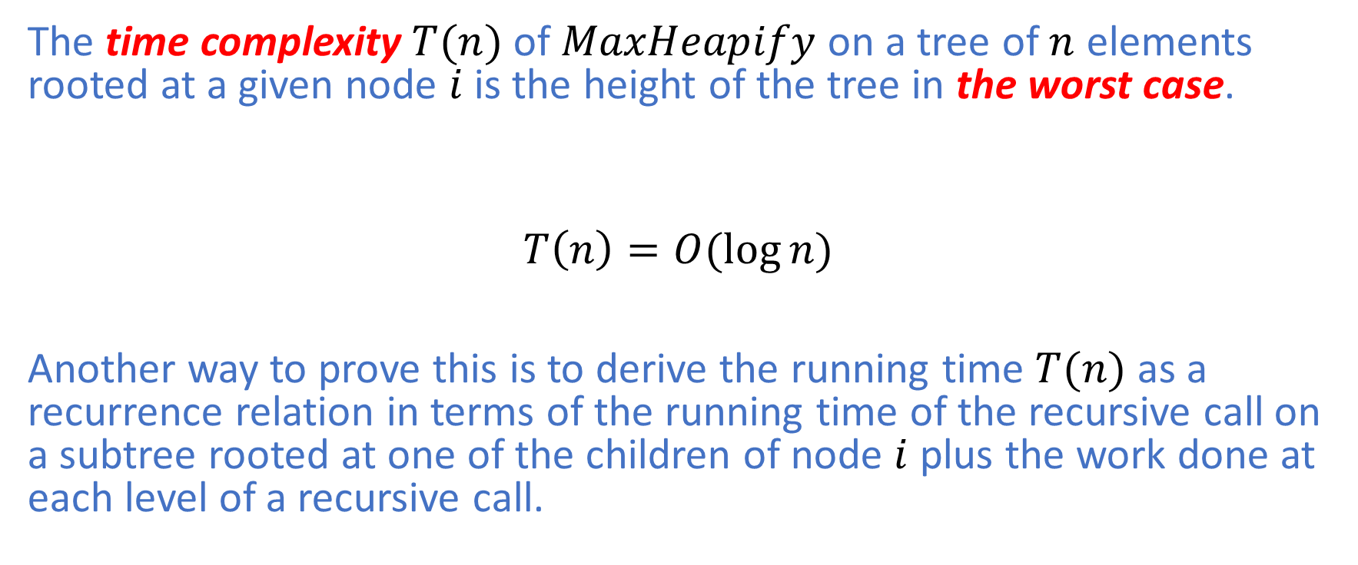
Time Complexity of Max-Heapify
The time complexity $T(n)$ of $MaxHeapify$ on a tree of $n$ elements rooted at a given node $i$ is the height of the tree in the worst case.
$$T\left(n\right)=O(\log{n})$$
Another way to prove this is to derive the running time $T(n)$ as a recurrence relation in terms of the running time of the recursive call on a subtree rooted at one of the children of node $i$ plus the work done at each level of a recursive call.

Slide 19
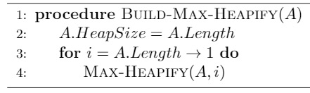

Build-Max-Heap
We can use $MaxHeapify$ in a bottom-up manner to convert an array $A[1…n]$ into a max heap as follows.
But, can we do better?

Slide 20
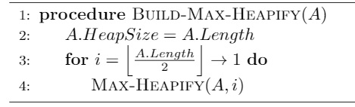
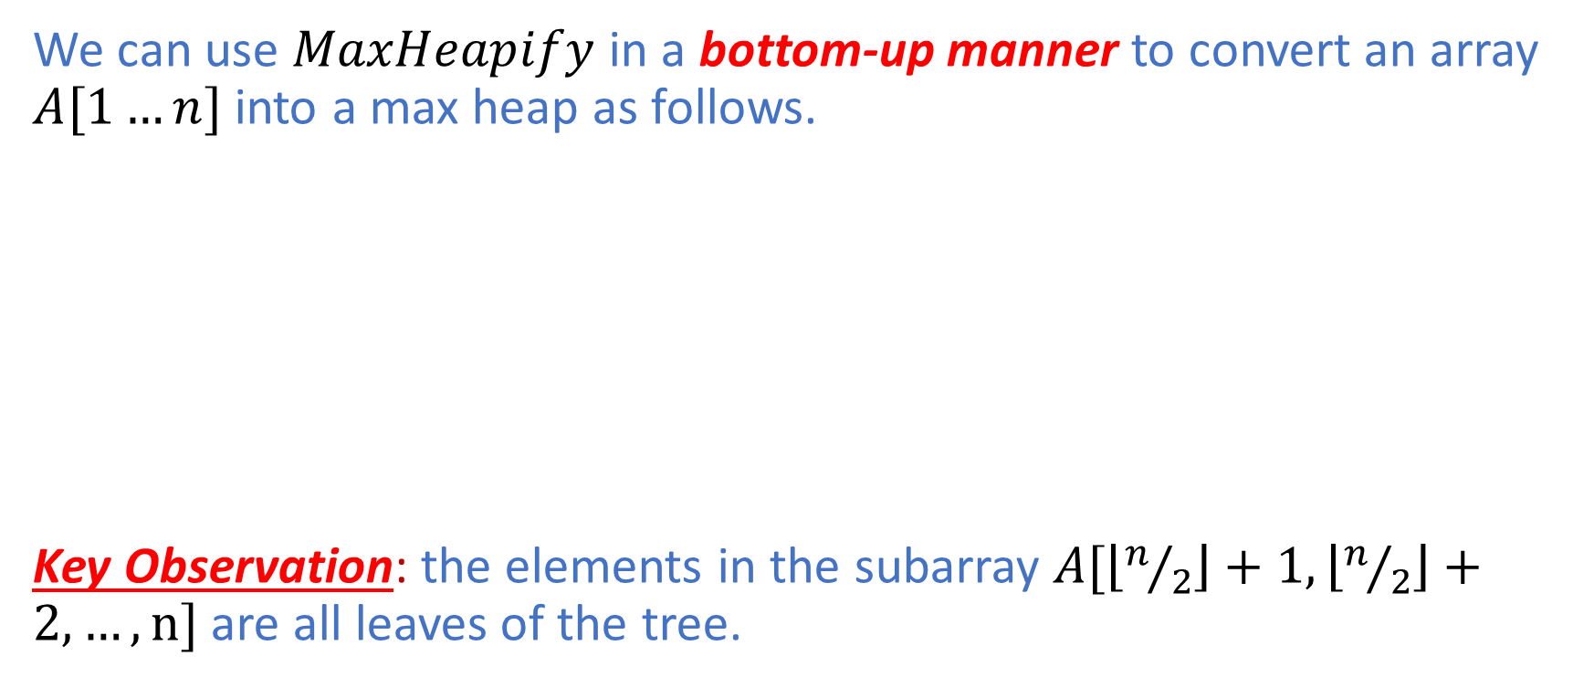
Build-Max-Heap
We can use $MaxHeapify$ in a bottom-up manner to convert an array $A[1…n]$ into a max heap as follows.
Key Observation: the elements in the subarray $A[\left\lfloor n/2\right\rfloor +1,\left\lfloor n/2\right\rfloor +2,…,n]$ are all leaves of the tree.

Slide 21
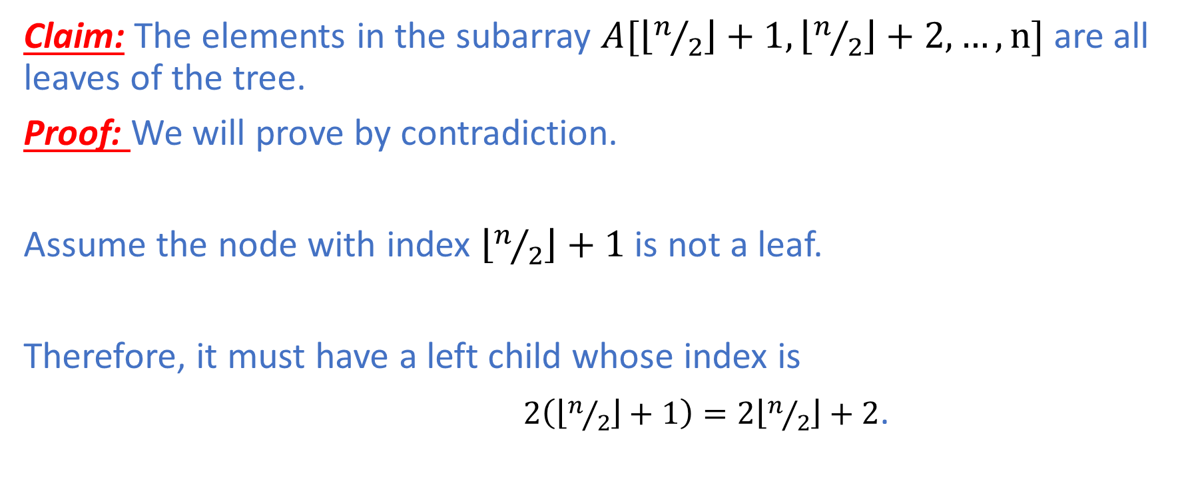
Build-Max-Heap
Claim: The elements in the subarray $A[\left\lfloor n/2\right\rfloor +1,\left\lfloor n/2\right\rfloor +2,…,n]$ are all leaves of the tree.
Proof: We will prove by contradiction.
Assume the node with index $\left\lfloor n/2\right\rfloor +1$ is not a leaf.
Therefore, it must have a left child whose index is
$2\left(\left\lfloor n/2\right\rfloor +1\right)=2\left\lfloor n/2\right\rfloor +2$.

Slide 22
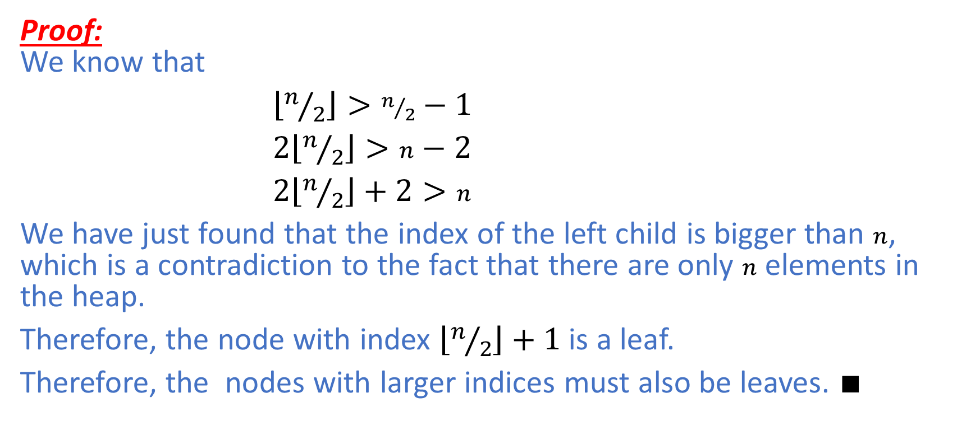
Build-Max-Heap
Proof: We know that
$\left\lfloor n/2\right\rfloor >n/2−1$
$2\left\lfloor n/2\right\rfloor >n−2$
$2\left\lfloor n/2\right\rfloor +2>n$
We have just found that the index of the left child is bigger than $n$, which is a contradiction to the fact that there are only $n$ elements in the heap.
Therefore, the node with index $\left\lfloor n/2\right\rfloor +1$ is a leaf.
Therefore, the nodes with larger indices must also be leaves. $∎$

Slide 23
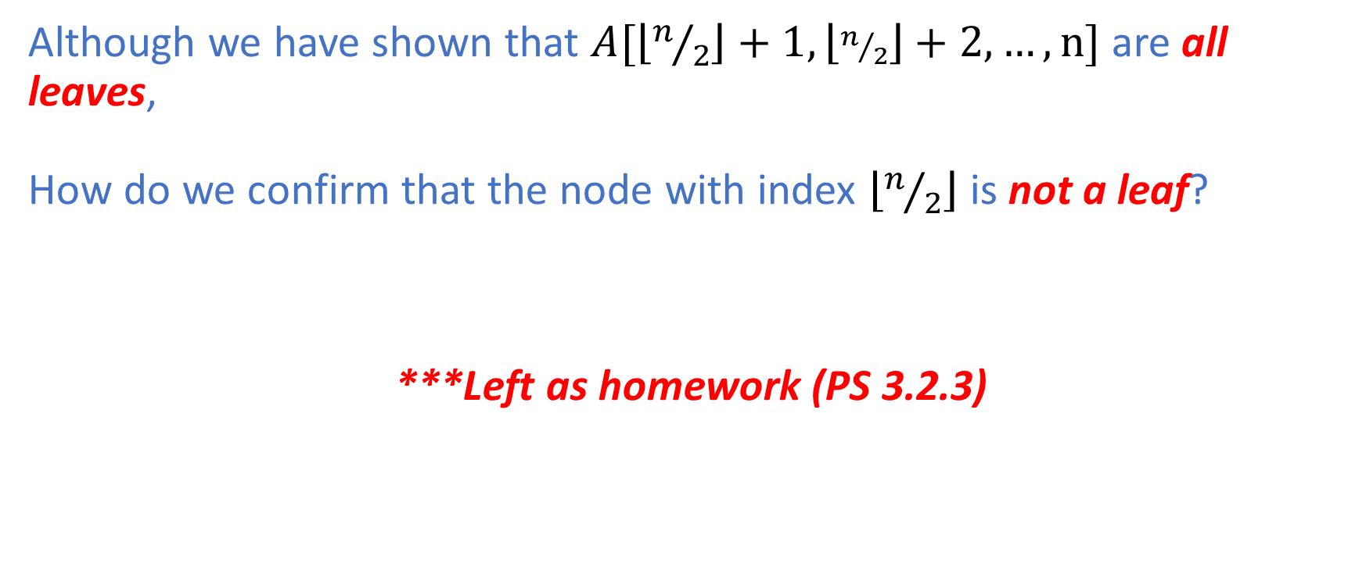
Build-Max-Heap
Although we have shown that $A[\left\lfloor n/2\right\rfloor +1,\left\lfloor n/2\right\rfloor +2,…,n]$ are all leaves, How do we confirm that the node with index $\left\lfloor n/2\right\rfloor$ is not a leaf?
***Left as homework (PS 3.2.3)

Slide 24
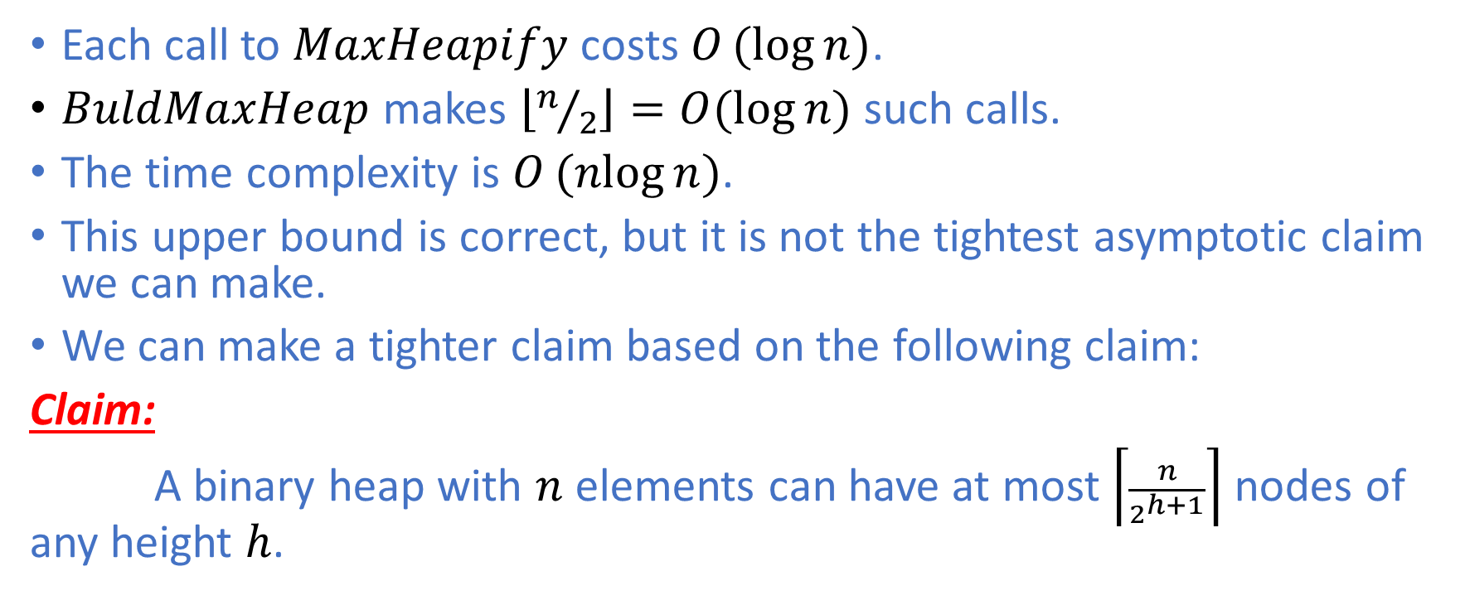
Time Complexity of Build-Max-Heap
Each call to $MaxHeapify$ costs $O(log{n)}$.
$BuldMaxHeap$ makes $\left\lfloor n/2\right\rfloor =O(\log{n})$ such calls.
The time complexity is $O(nlog{n)}$.
This upper bound is correct, but it is not the tightest asymptotic claim we can make.
We can make a tighter claim based on the following claim:
Claim:
A binary heap with $n$ elements can have at most $\left\lceil \frac{n}{2^{h+1}}\right\rceil$ nodes of any height $h$.

Slide 25
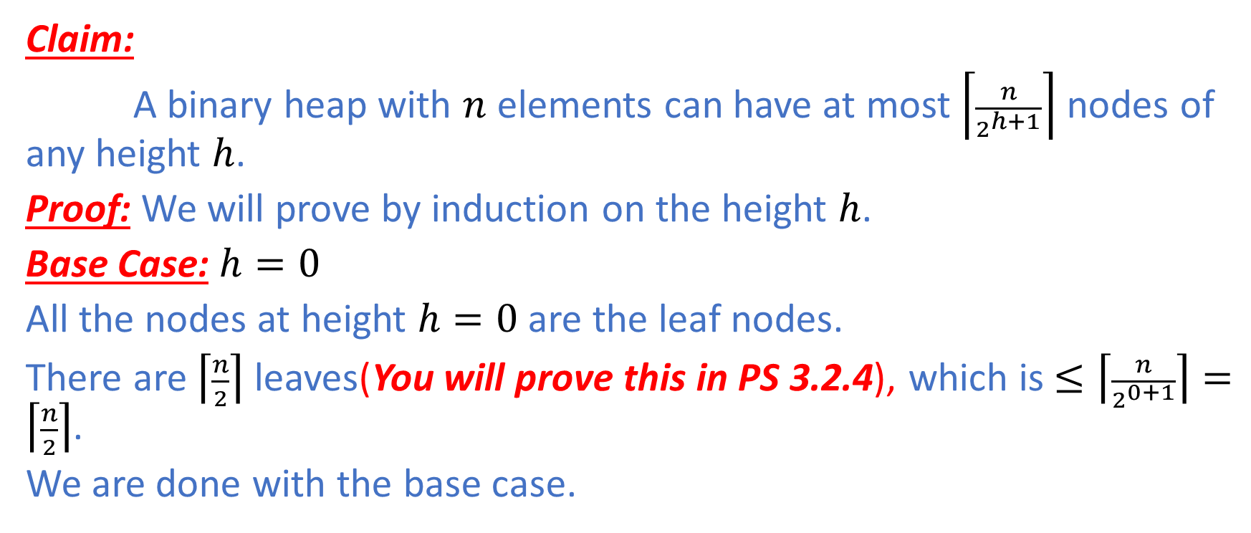
Structural Induction on the Binary Heap
Claim:
A binary heap with $n$ elements can have at most $\left\lceil \frac{n}{2^{h+1}}\right\rceil$ nodes of any height $h$.
Proof: We will prove by induction on the height $h$.
Base Case: $h=0$
All the nodes at height $h=0$ are the leaf nodes.
There are $\left\lceil \frac{n}{2}\right\rceil$ leaves(You will prove this in PS 3.2.4), which is $≤\left\lceil \frac{n}{2^{0+1}}\right\rceil =\left\lceil \frac{n}{2}\right\rceil$.
We are done with the base case.

Slide 26
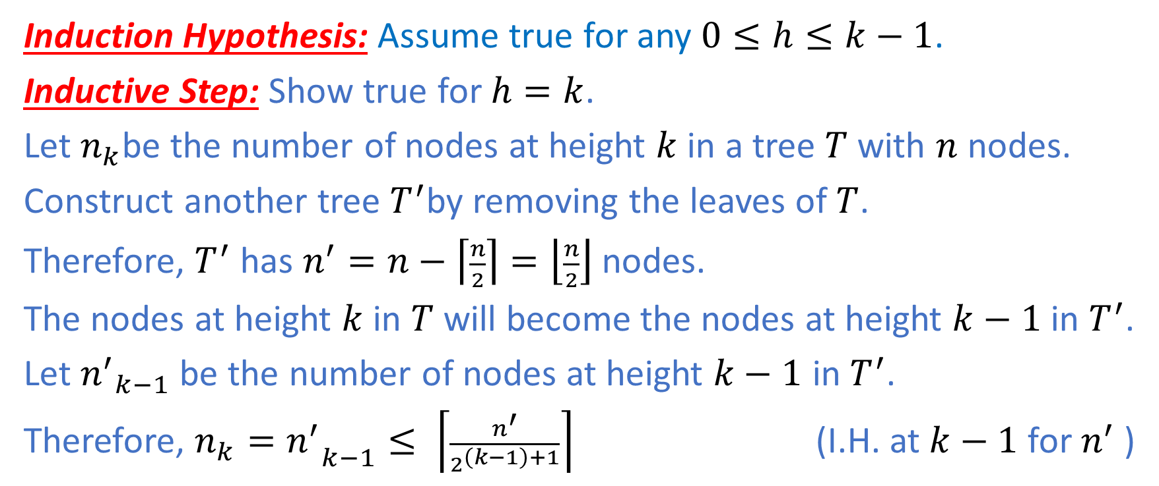
Time Complexity of Build-Max-Heap
Induction Hypothesis: Assume true for any $0≤h≤k−1$.
Inductive Step: Show true for $h=k$.
Let $n_{k}$be the number of nodes at height $k$ in a tree $T$ with $n$ nodes.
Construct another tree $T^{′}$by removing the leaves of $T$.
Therefore, $T^{′}$ has $n^{′}=n−\left\lceil \frac{n}{2}\right\rceil =\left\lfloor \frac{n}{2}\right\rfloor$ nodes.
The nodes at height $k$ in $T$ will become the nodes at height $k−1$ in $T^{′}$.
Let ${n^{′}}_{k−1}$ be the number of nodes at height $k−1$ in $T^{′}$.
Therefore, ${{n_{k}=n}^{′}}_{k−1}≤ \left\lceil \frac{n^{′}}{2^{\left(k−1\right)+1}}\right\rceil$ (I.H. at $k−1$ for $n^{′}$ )

Slide 27
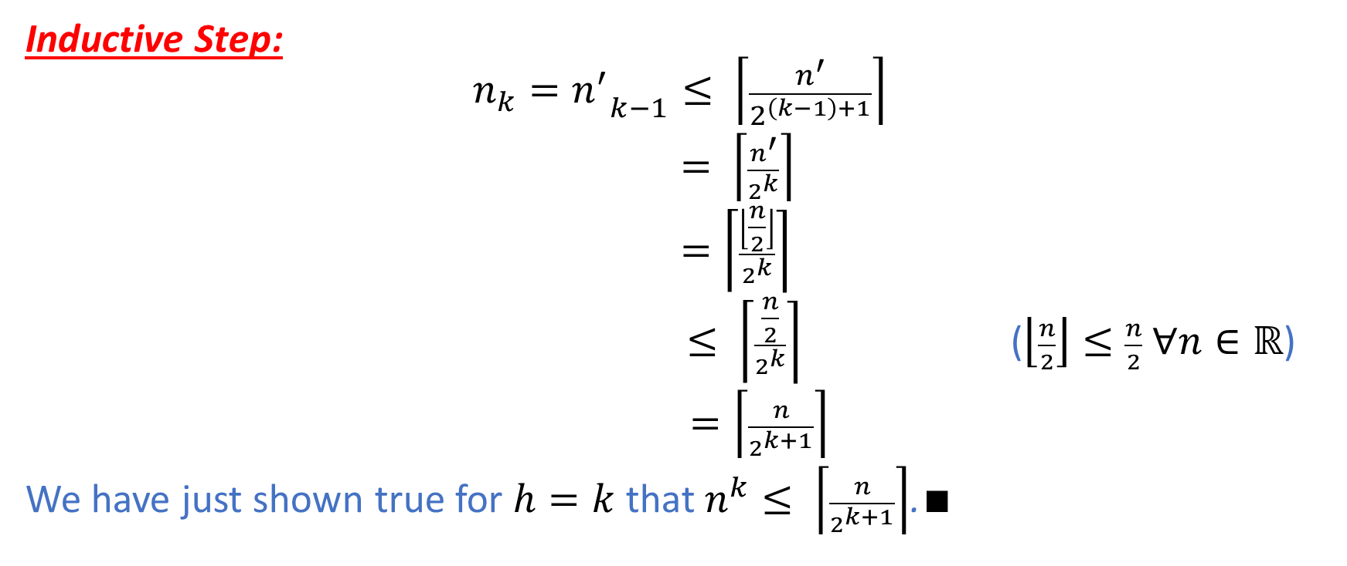
Time Complexity of Build-Max-Heap
Inductive Step:
$${{n_{k}=n}^{′}}_{k−1}≤ \left\lceil \frac{n^{′}}{2^{\left(k−1\right)+1}}\right\rceil$$
$= \left\lceil \frac{n^{′}}{2^{k}}\right\rceil$
$=\left\lceil \frac{\left\lfloor \frac{n}{2}\right\rfloor }{2^{k}}\right\rceil$
$≤ \left\lceil \frac{\frac{n}{2}}{2^{k}}\right\rceil$ ($\left\lfloor \frac{n}{2}\right\rfloor ≤\frac{n}{2}$ $∀n∈ℝ$)
$=\left\lceil \frac{n}{2^{k+1}}\right\rceil$
We have just shown true for $h=k$ that $n^{k}≤ \left\lceil \frac{n}{2^{k+1}}\right\rceil$.$∎$

Slide 28
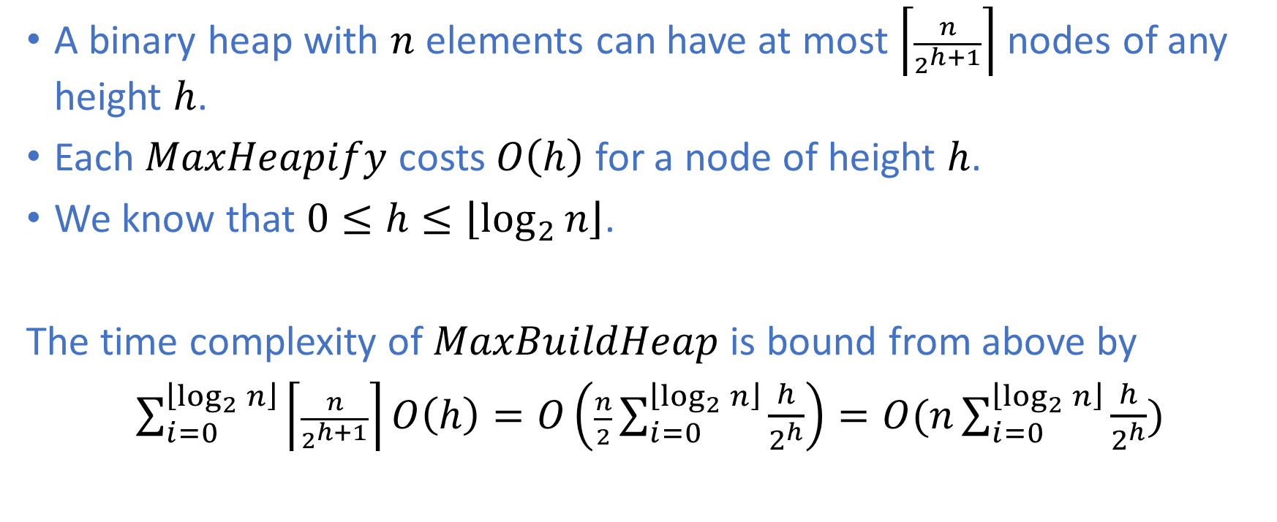
Time Complexity of Build-Max-Heap
A binary heap with $n$ elements can have at most $\left\lceil \frac{n}{2^{h+1}}\right\rceil$ nodes of any height $h$.
Each $MaxHeapify$ costs $O\left(h\right)$ for a node of height $h$.
We know that $0≤h≤\left\lfloor \log_{2}{n}\right\rfloor$.
The time complexity of $MaxBuildHeap$ is bound from above by
$\sum_{i=0}^{\left\lfloor \log_{2}{n}\right\rfloor }{\left\lceil \frac{n}{2^{h+1}}\right\rceil }O\left(h\right)=O\left(\frac{n}{2}\sum_{i=0}^{\left\lfloor \log_{2}{n}\right\rfloor }{\frac{h}{2^{h}}}\right)=O(n\sum_{i=0}^{\left\lfloor \log_{2}{n}\right\rfloor }{\frac{h}{2^{h}}})$

Slide 29
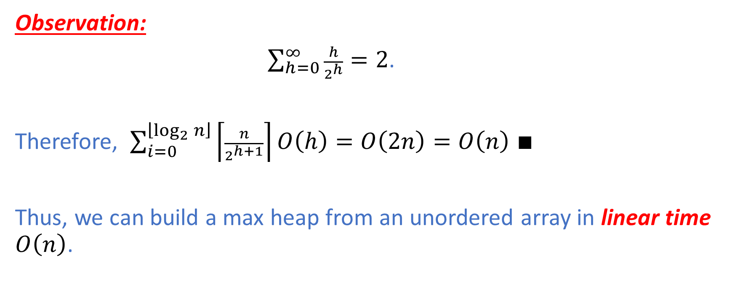
Time Complexity of Build-Max-Heap
Observation:
$\sum_{h=0}^{∞}{\frac{h}{2^{h}}=2}$.
Therefore, $\sum_{i=0}^{\left\lfloor \log_{2}{n}\right\rfloor }{\left\lceil \frac{n}{2^{h+1}}\right\rceil }O\left(h\right)=O\left(2n\right)=O\left(n\right)$ $∎$
Thus, we can build a max heap from an unordered array in linear time $O\left(n\right)$.

Slide 30
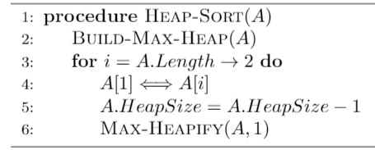
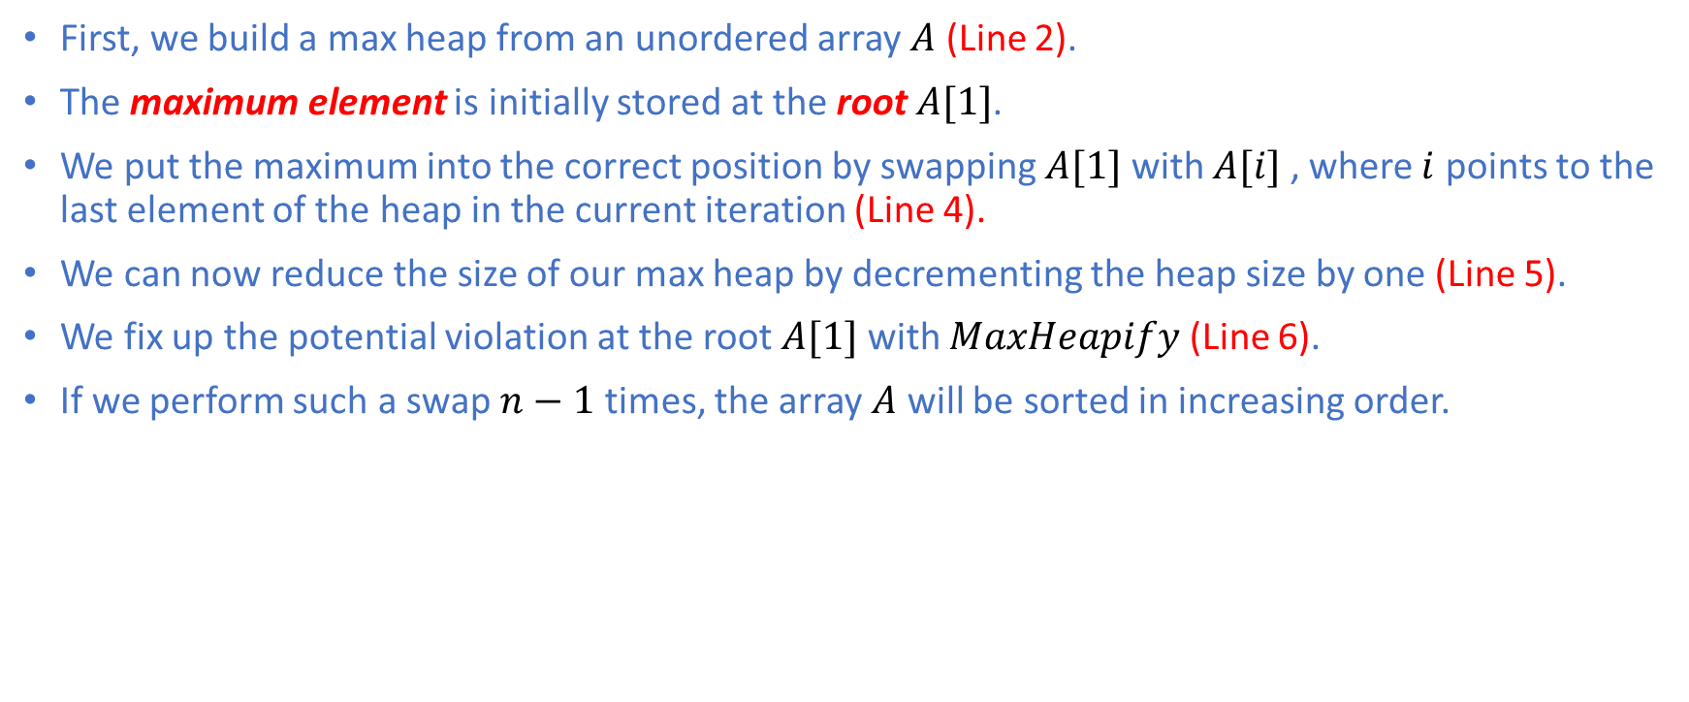
Heap Sort
First, we build a max heap from an unordered array $A$ (Line 2).
The maximum element is initially stored at the root $A[1]$.
We put the maximum into the correct position by swapping $A[1]$ with $A[i]$ , where $i$ points to the last element of the heap in the current iteration (Line 4).
We can now reduce the size of our max heap by decrementing the heap size by one (Line 5).
We fix up the potential violation at the root $A[1]$ with $MaxHeapify$ (Line 6).
If we perform such a swap $n−1$ times, the array $A$ will be sorted in increasing order.

Slide 31

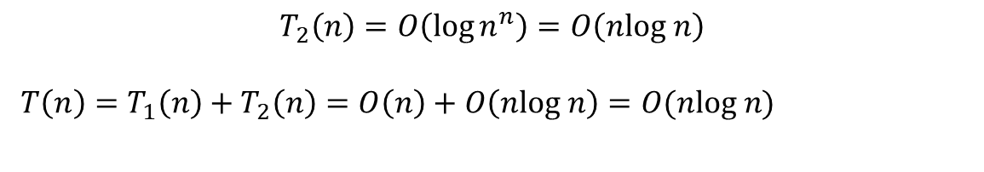
The time complexity of Heap Sort
Analysis:
$BuildMaxHeap$ costs $T_{1}(n)=O(n)$ time.
Each call to $MaxHeapify$ costs $O(\log{k) }$time for $k=n,n−1,…,2$.
The total cost of $MaxHeapify$ $T_{2}(n)$ is
$$T_{2}\left(n\right)=\sum_{k=n}^{2}{O(\log{k)=}}O\left(\sum_{k=1}^{n}{\log{k}}\right)=O\left(log n!\right)$$
Key Observation: $log n!≤ log n^{n}=n log{n} ∀n≥1$
$$T_{2}\left(n\right)=O\left(\log{n^{n}}\right)=O\left(nlog n\right)$$
${{T\left(n\right)=T}_{1}\left(n\right)+T}_{2}\left(n\right)=O\left(n\right)+O\left(nlog n\right)=O(nlog n)$

Slide 32
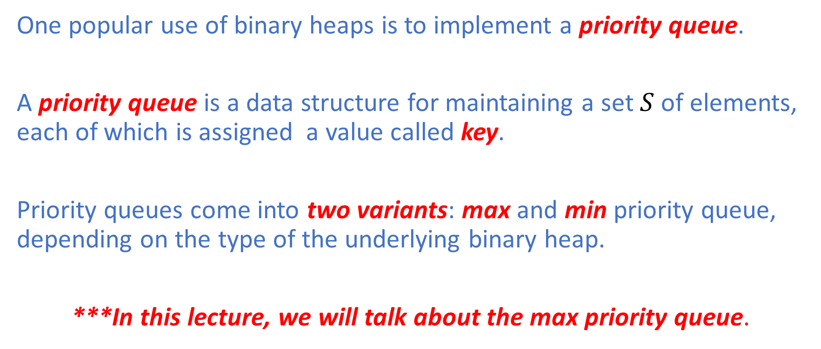
Priority Queue
One popular use of binary heaps is to implement a priority queue.
A priority queue is a data structure for maintaining a set $S$ of elements, each of which is assigned a value called key.
Priority queues come into two variants: max and min priority queue, depending on the type of the underlying binary heap.
***In this lecture, we will talk about the max priority queue.

Slide 33
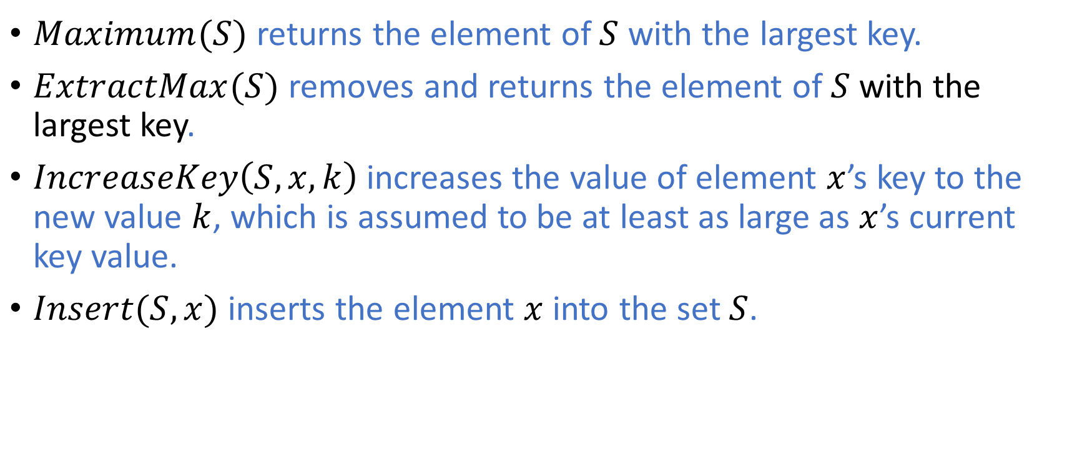
Basic Operations
$Maximum(S)$returns the element of $S$ with the largest key.
$ExtractMax(S)$ removes and returns the element of $S$ with the largest key.
$IncreaseKey\left(S,x,k\right)$ increases the value of element $x$’s key to the new value $k$, which is assumed to be at least as large as $x$’s current key value.
$Insert(S,x)$ inserts the element $x$into the set $S$.

Slide 34


Maximum
An element with the largest key value is stored at the root $A[1]$.
The operation has a constant time complexity $O(1)$.

Slide 35
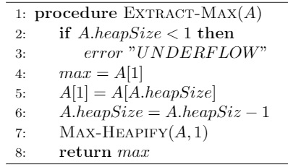


Extract-Max
The time complexity of $ExtractMax$ is $O(\log{n)}$ since it performs only constant time operations before it performs $MaxHeapify$ on the root $A[1]$, which costs $O(\log{n)}$.
1) Save the value of the root element (Line 4)
2) Swap the element at the root with the last leaf element. (Line 5)
***At this point, the max heap property might have been violated.
3) Decrease the size of the heap by one, which effectively discards the extracted max element (Line 6)
4) Fix up the heap by calling $MaxHeapify$ on the root (Line 7)
5) Return the extracted element with the largest value (Line 8)

Slide 36
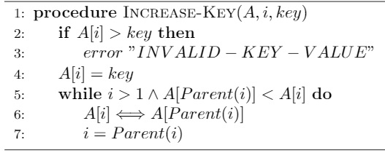


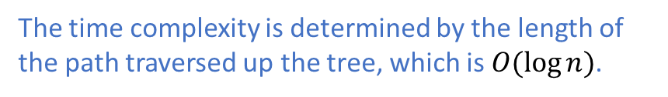
Increase-Key
An index $i$ is to point to the element $A[i]$ whose key value we want to increase.
Key Assumption: The new key $key$ value must be at least as large as the current key value of $A\left[i\right].$ Otherwise, it is an error. (Lines 2 & 3)
If the new key value is ok,
Assign $A[i]$ the new key value $key$ (Line 4)
***At this point, the max heap property might have been violated.
Traverse a simple path from $A[i]$ towards the root to find a proper place for the new key value (Lines 5&6&7)
The time complexity is determined by the length of the path traversed up the tree, which is $O(\log{n)}$.

Slide 37
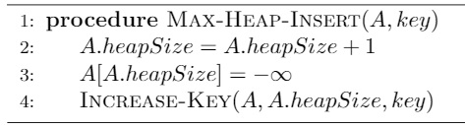


Max-Heap-Insert
$MaxHeapInsert$ takes as input the key of a new element $key$ to be inserted into the max heap $A$.
Expand the max heap by incrementing the size by one (Line 2)
Add a new element with key value $−∞$ (Line 3)
Call $IncreaseKey$ to set the key value of the newly inserted element to $key$ and make sure the max heap property is maintained (Line 4)
The time complexity of $MaxHeapInsert$ is $O(\log{n)}$ since it performs constant time work before it calls $Increasekey$, which runs in $O(\log{n)}$ time.

Slide 38
Summary
We have covered the following data structures today:
Stack
Queue
Heap
Priority Queue
We have also illustrated a new variant of mathematical induction known as structural induction. We will cover Part II of Data Structures in the next lecture.

